Slide 1

Useful open science tools to do research in psychiatry
Thomas Gargot
thomas_gargot@hotmail.com
EPA Congress,
Tuesday March 6th
Notes:
CLEAN DESKTOP, APP +++
Prepare the video
Who already know about open science
Wikipedia
Equator network
Like cakes ?
Background on stats
Already published an article
Already analysed data ?
R
Python
GitHub
Who has a computer with him ?
Who has R studio and python on it ?

Slide 2



Who I am
Psychiatrist in Paris
PhD Student on Computer Science :
use of IT for neurodevelopmental disorders in school
Interest in IT and psychotherapy (CBT)
animation team of the EPA CBT MOOC, April 9th
Former IT secretary of EFPT
Psychotherapy WG chairman

Slide 3






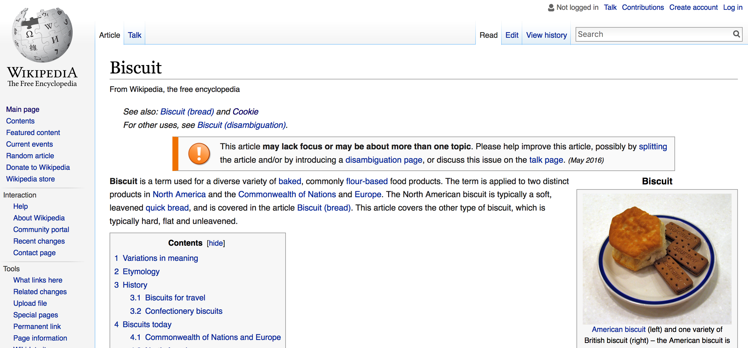
Randomizer.org
Useful open science tools to do research in psychiatry
Collect data
Limesurvey
Analyse data
Share data
OSF and
GitHub
Write an article
Make the knowledge more visible

Slide 4
Goals of the workshop
Understand the challenges of open science
Learn the names of few tools
Consider you own research/projects
Rate cakes

Slide 5
Disclosure
None

Slide 6
Ethical issues

Slide 7
Problems
Cost : How much will it cost to run this study?
Licence : Does someone has the last version of this software ?
Paywall : I can’t get this article
Method : What do they mean when they did this analysis?
Memory: where is my data, how to re-use, share it?
Visibility: Nobody cares about what us

Slide 8


Slide 9

Publication lucrative vicious circle
Collect articles for free
Paywall and Sell it
Reviewing for free
Publishing
(cost decrease)
Research privatization

Slide 10
Goals
Dicrease costs
Improve transparency
Improve accessibility to softwares, data, articles,
Improve visibility for public
Is that really possible ?!?

Slide 11
Information world
Share of information don’t decrease the ownership of the sharer
Rather, better accessibility improve possibilities of not anticipated use (hacking) and feedback
Open softwares are more flexible and have fewer bugs that closed one

Slide 12

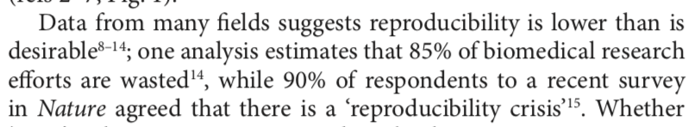
Why is there a need for open science?

Slide 13

Free / Open?
Open software: Free use, study, modification, duplication and sharing
≠ Freemium strategy (demonstration)
≠ centralisation and user data collection
https://www.qwant.com/?q=you%20are%20the%20product&t=images&o=0:0a530ac5ad25daeb329762e4a2da88f3

Slide 14
An example of Open science pathway
Hands-on

Slide 15
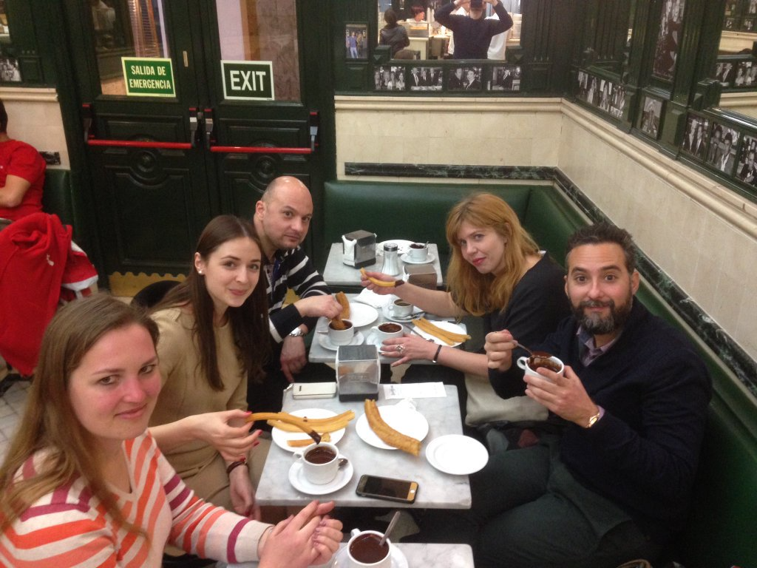
Research protocol
Make a data base of cookies tasting
Rate them in an international context
Select the best cakes in the world
Sampling process during EPA congress, Madrid, 2016

Slide 16


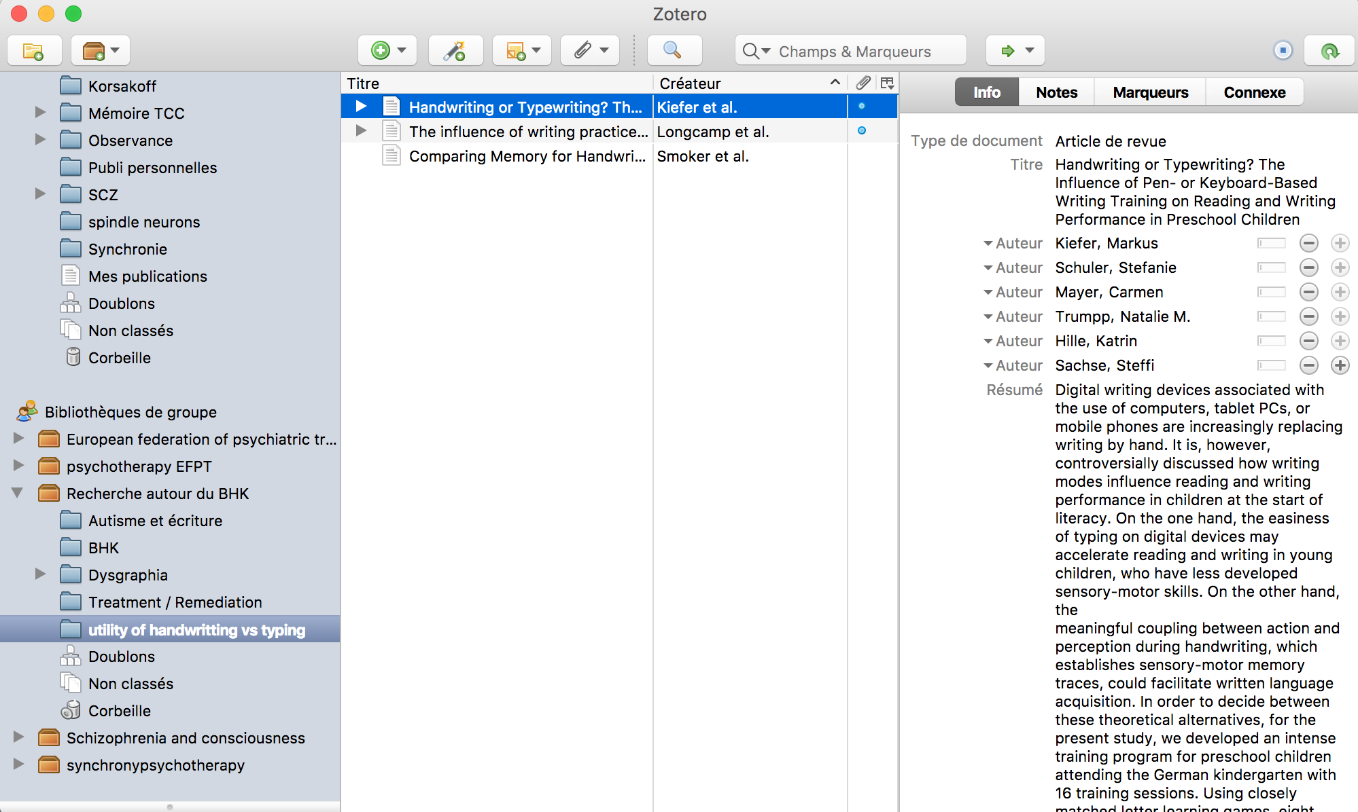
Select, gather, write and share bibliography

Slide 17
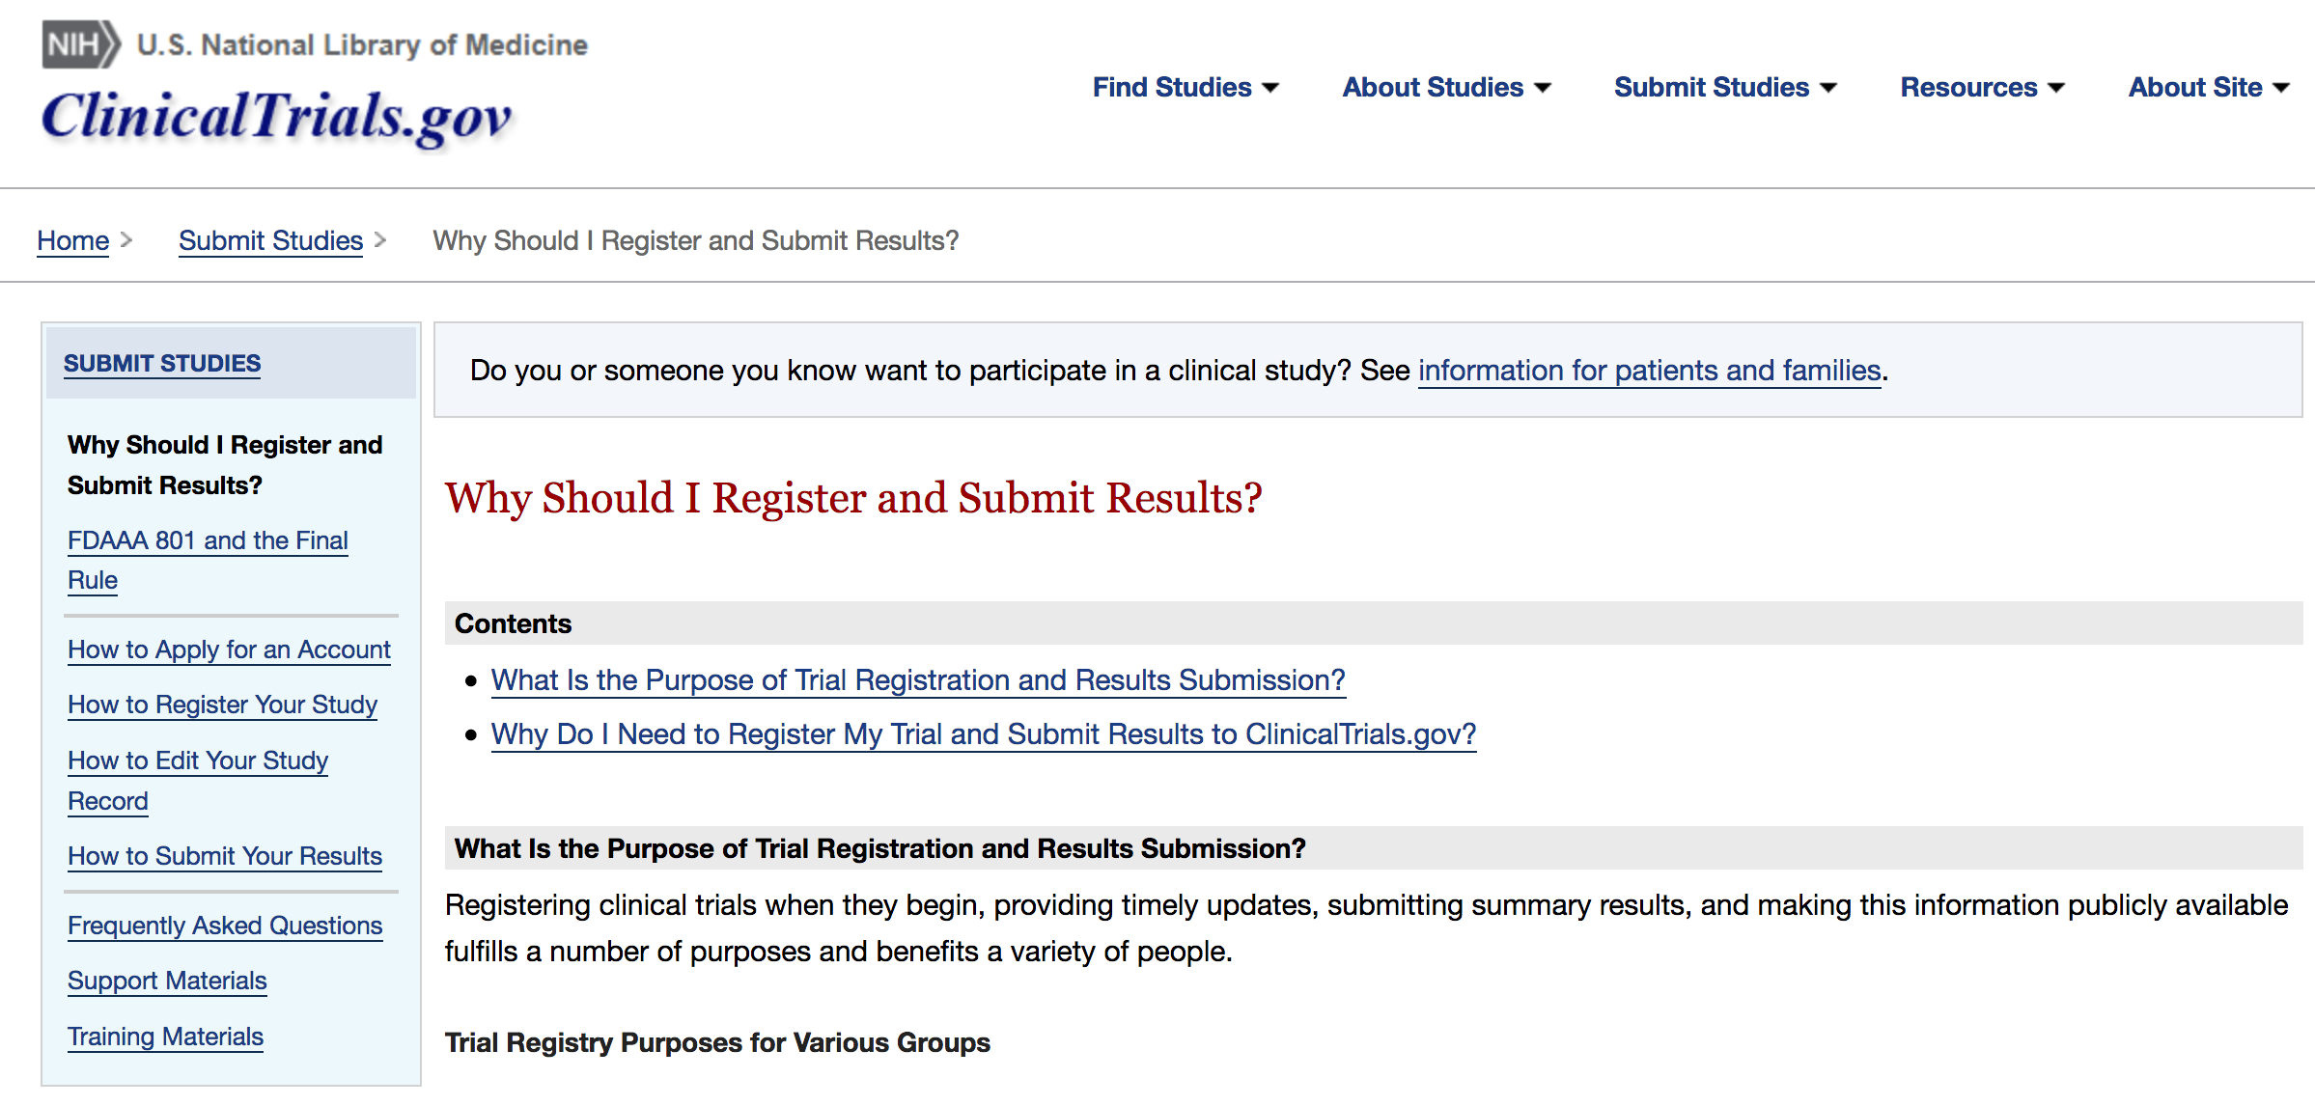
Preregistration

Slide 18
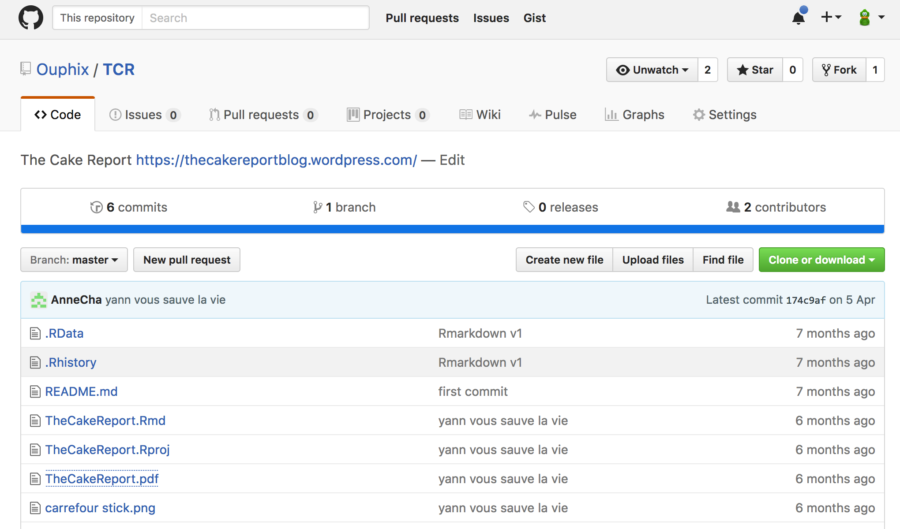
Git Hub
http://bit.ly/2sYQpkY
Share data

Slide 19
Randomizer.org
Useful open science tools to do research in psychiatry

Slide 20
Randomizer.org

Slide 21
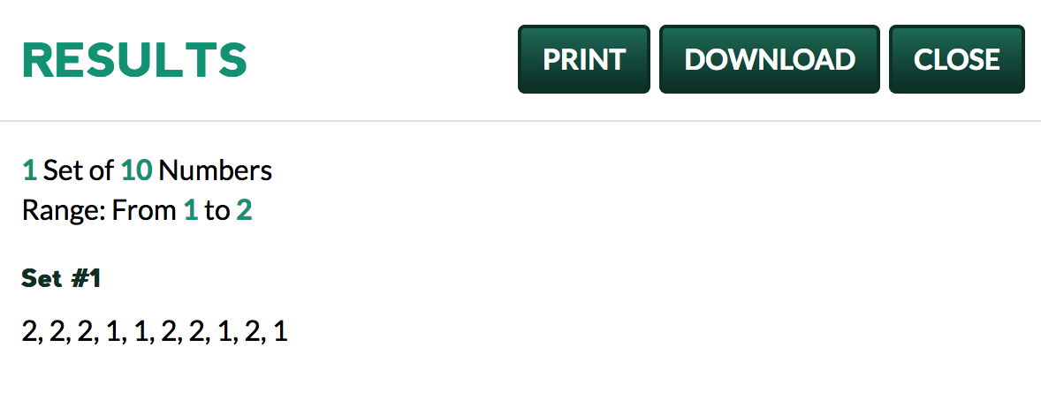
Randomizer.org
Notes:
50 sets of 2 numbers between 1 nad 2

Slide 22
Randomizer.org
Useful open science tools to do research in psychiatry
Collect data
Limesurvey

Slide 23

Limesurvey
http://bit.ly/2FFBcbe

Slide 24
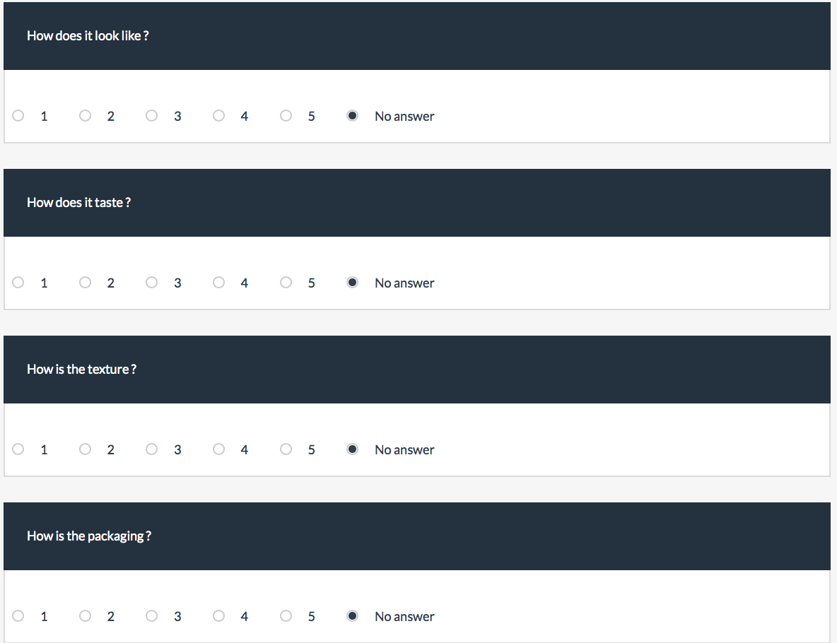

Slide 25
Randomizer.org
Useful open science tools to do research in psychiatry
Collect data
Limesurvey
Analyse data

Slide 26
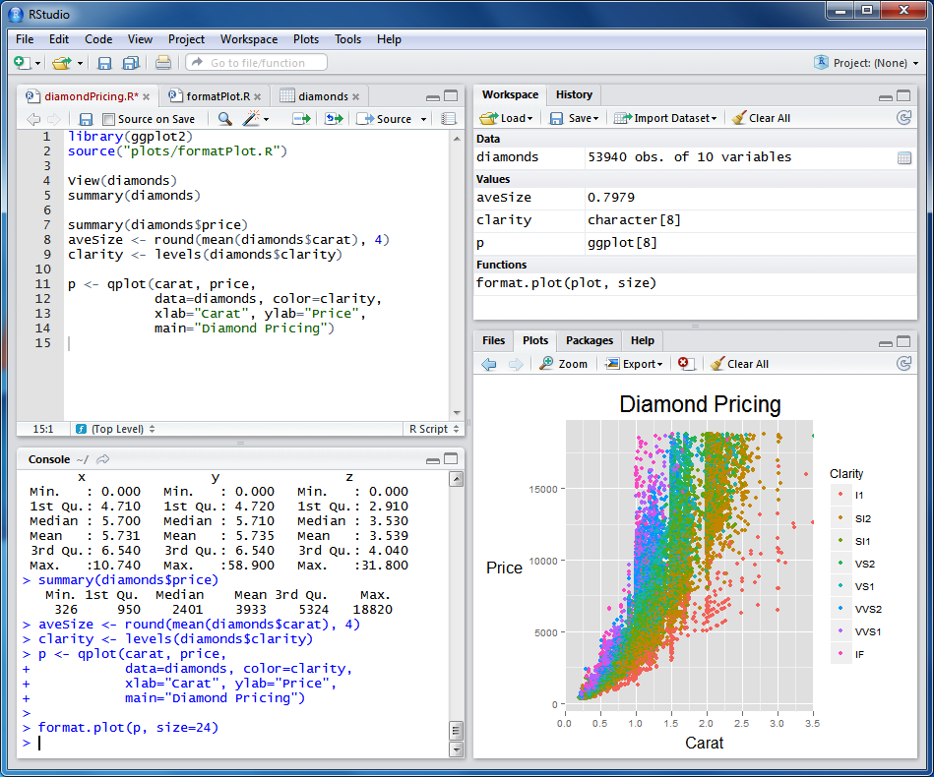

Slide 27
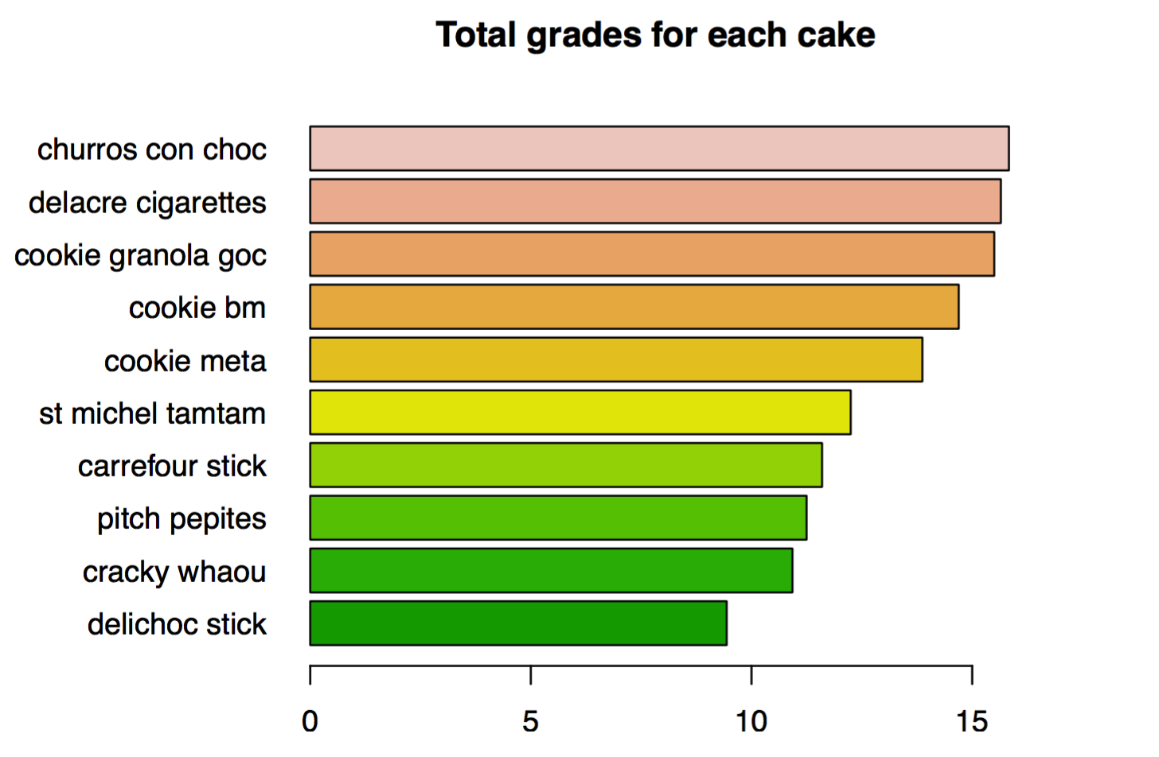

Slide 28
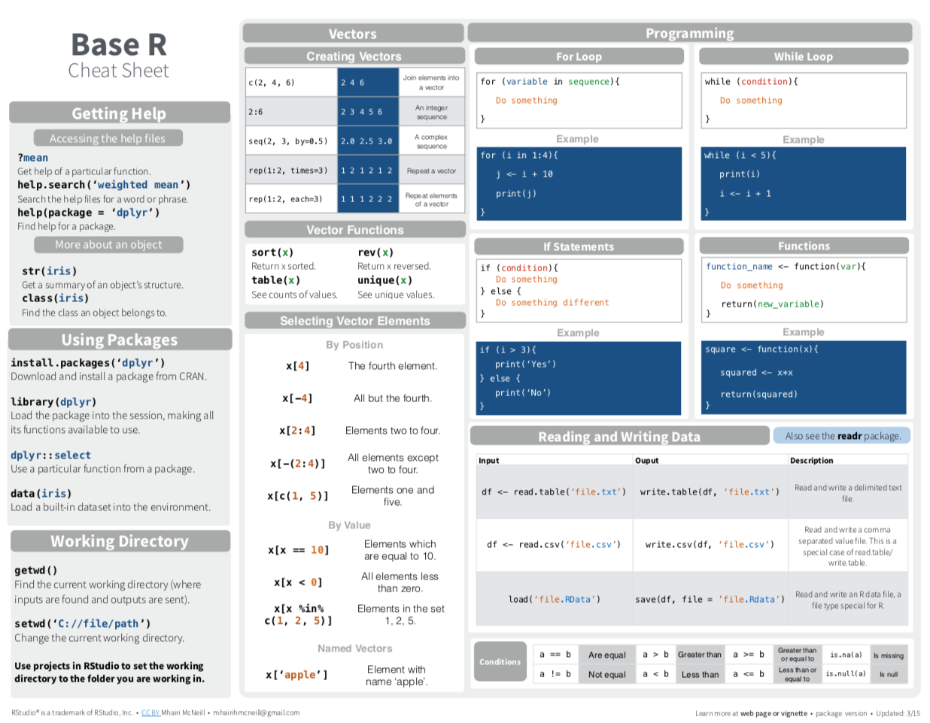
https://www.coursera.org/specializations/jhu-data-science
https://python-graph-gallery.com/
https://www.datacamp.com/

Slide 29
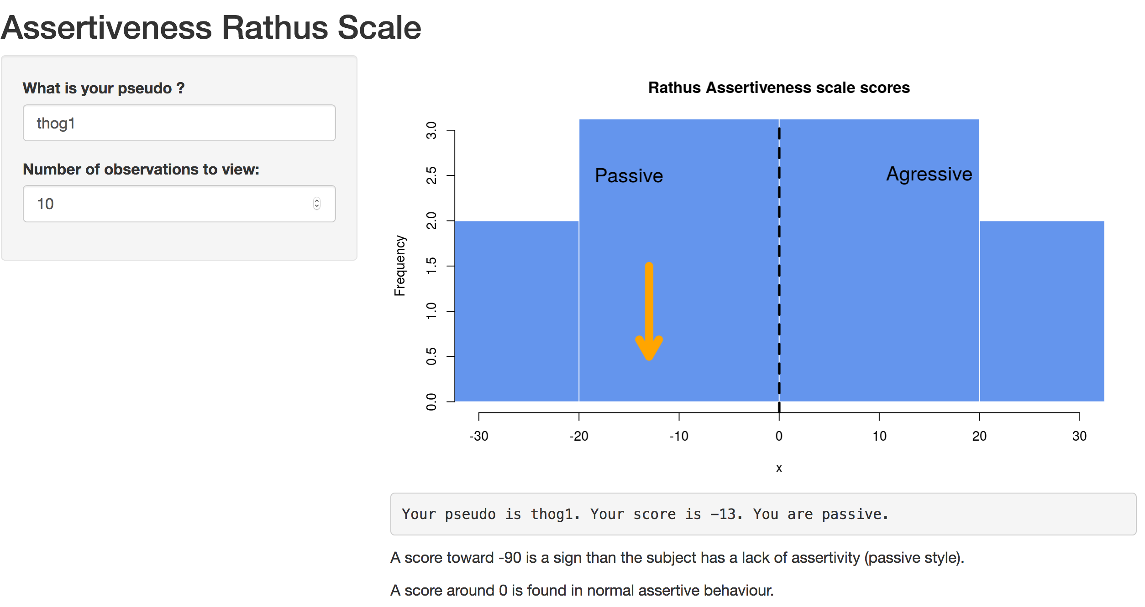
Connect Limesurvey with R ? : Shinyapps
https://ouphix.shinyapps.io/affiDeSoi/

Slide 30
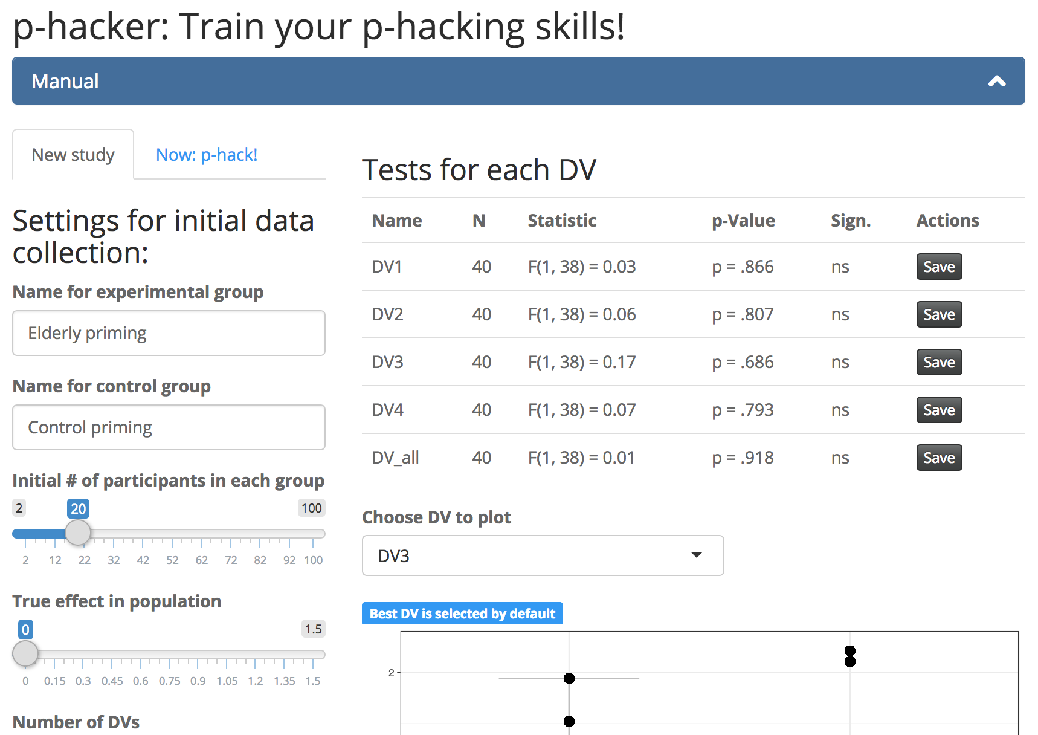
p-Hacker
http://shinyapps.org/apps/p-hacker/
http://shinyapps.org/apps/p-hacker/

Slide 31


Python
A little more fundamental and less user friendly, very used by computer scientists.
Python has very large possibilities :
collect data during a psychological experiment with pygame
Data analysis
Code a robot
Make a website

Slide 32
Randomizer.org
Useful open science tools to do research in psychiatry
Collect data
Limesurvey
Analyse data
Share data
OSF and
GitHub

Slide 33
Git Hub
http://bit.ly/2sYQpkY
Share data

Slide 34
Randomizer.org
Useful open science tools to do research in psychiatry
Collect data
Limesurvey
Analyse data
Share data
OSF and
GitHub
Write an article

Slide 35
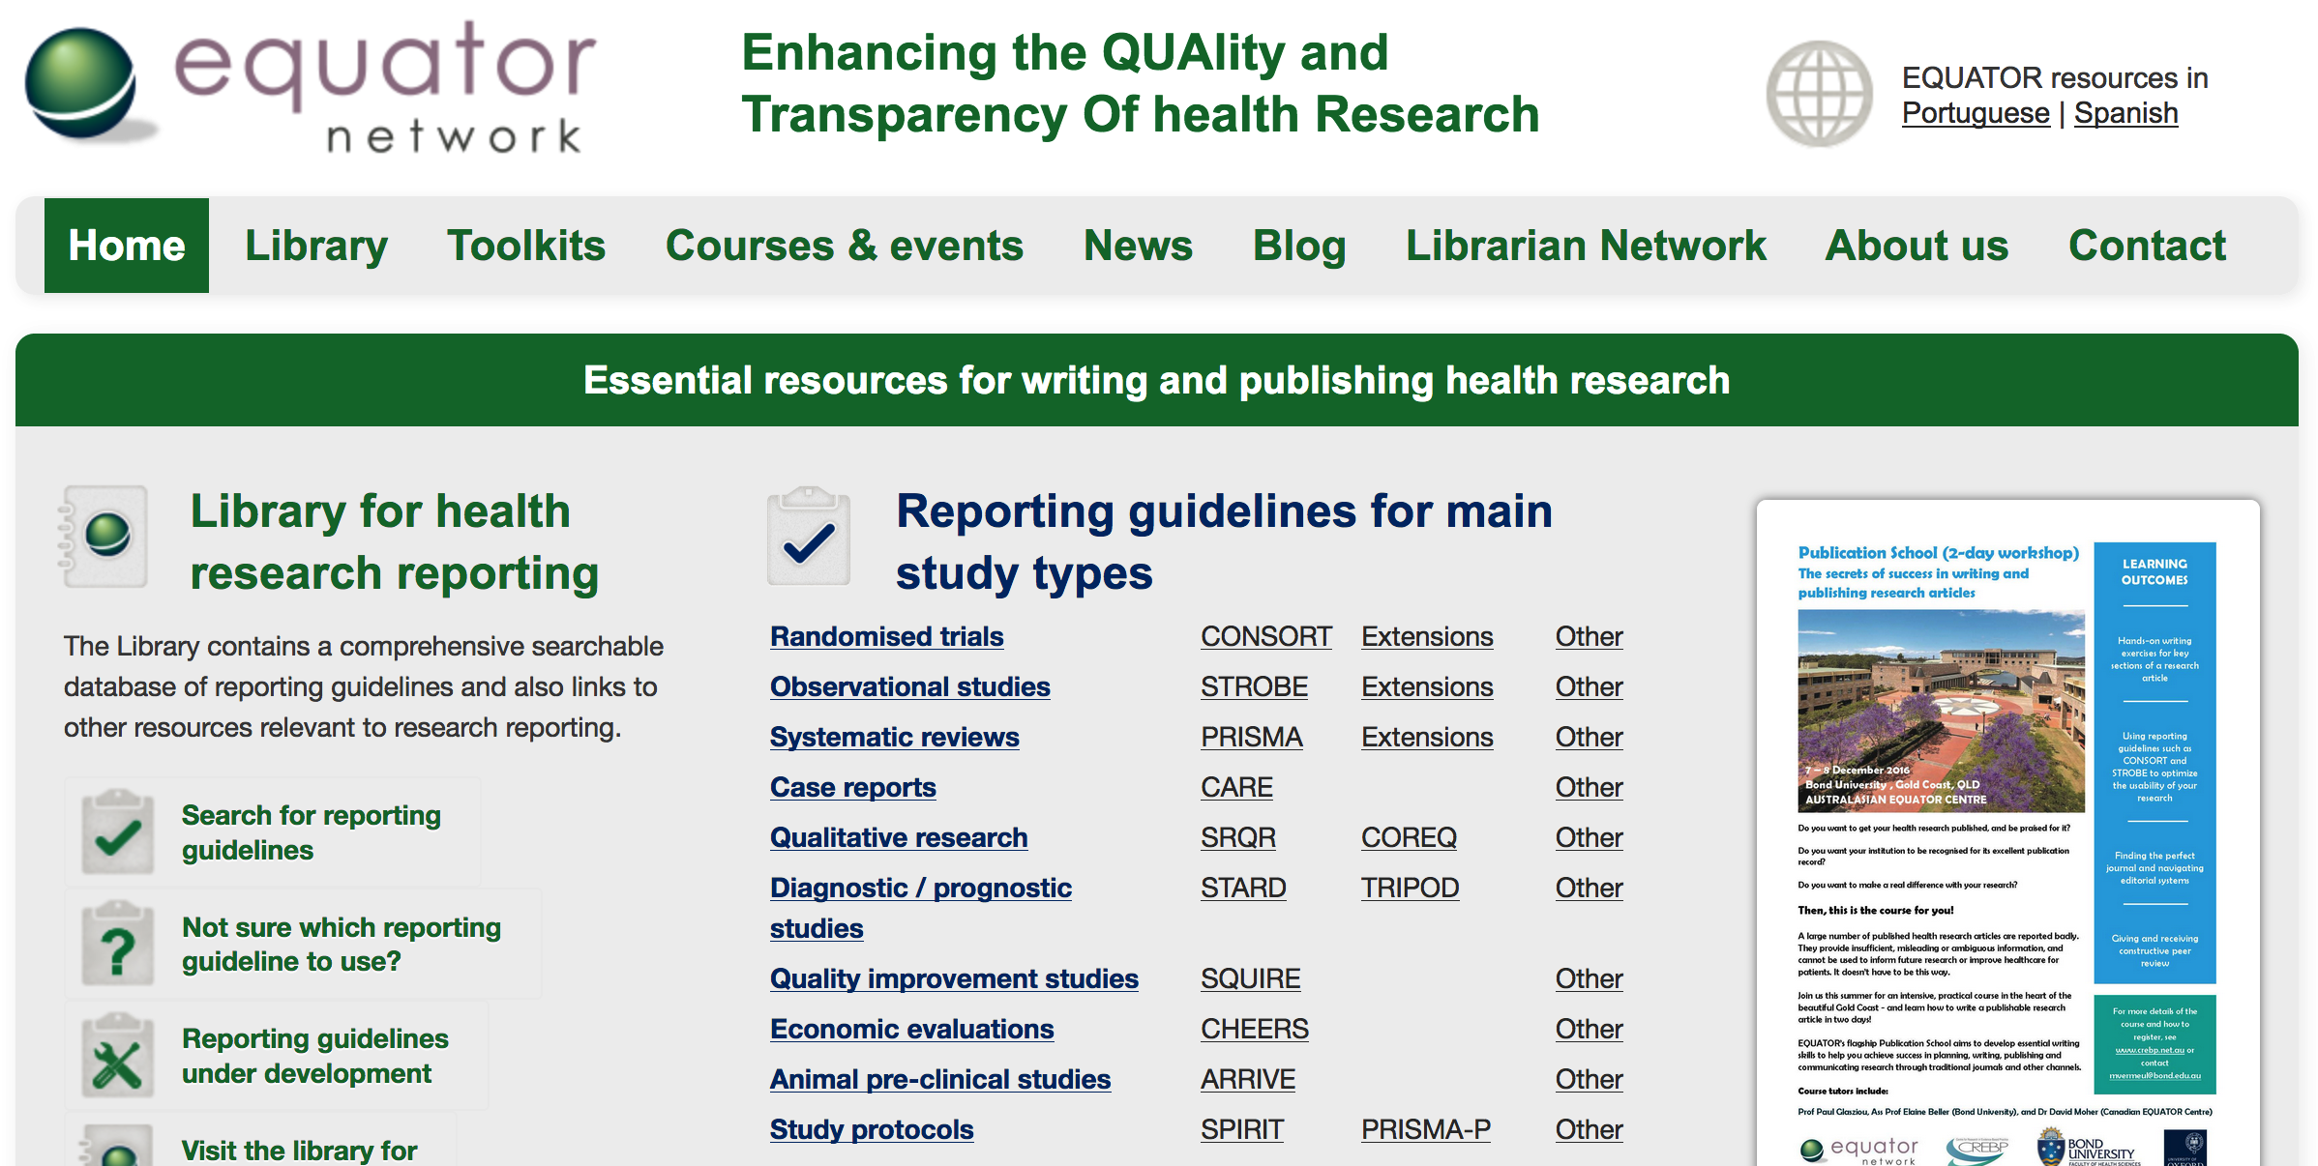
Equator Network

Slide 36
Collaborative writting

Slide 37
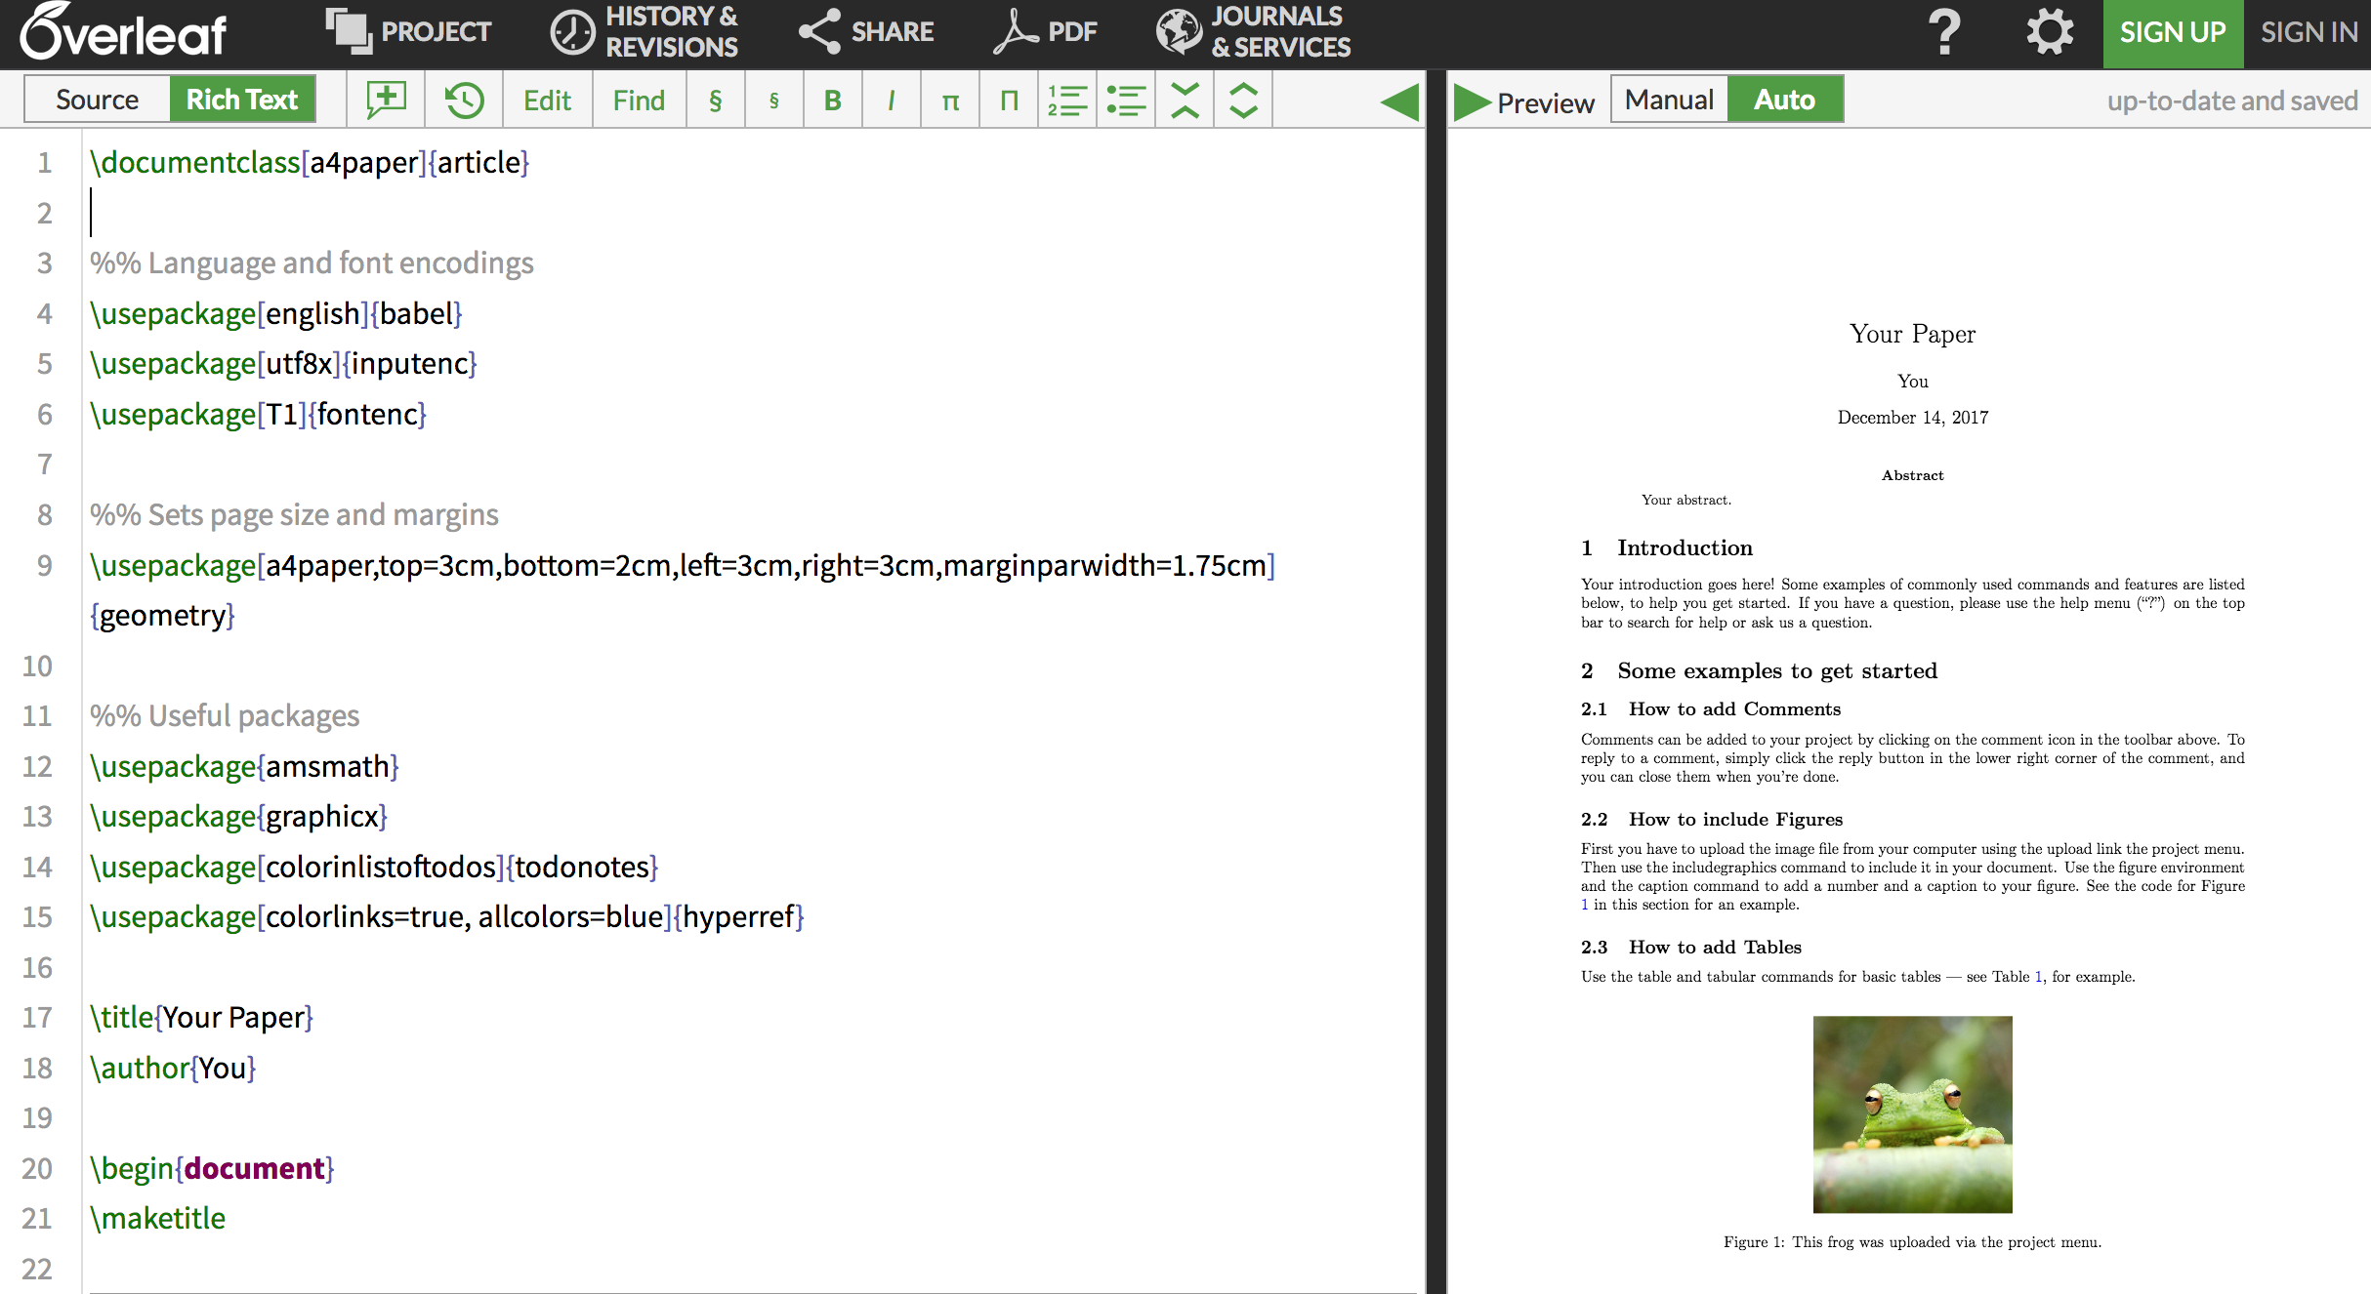

Slide 38
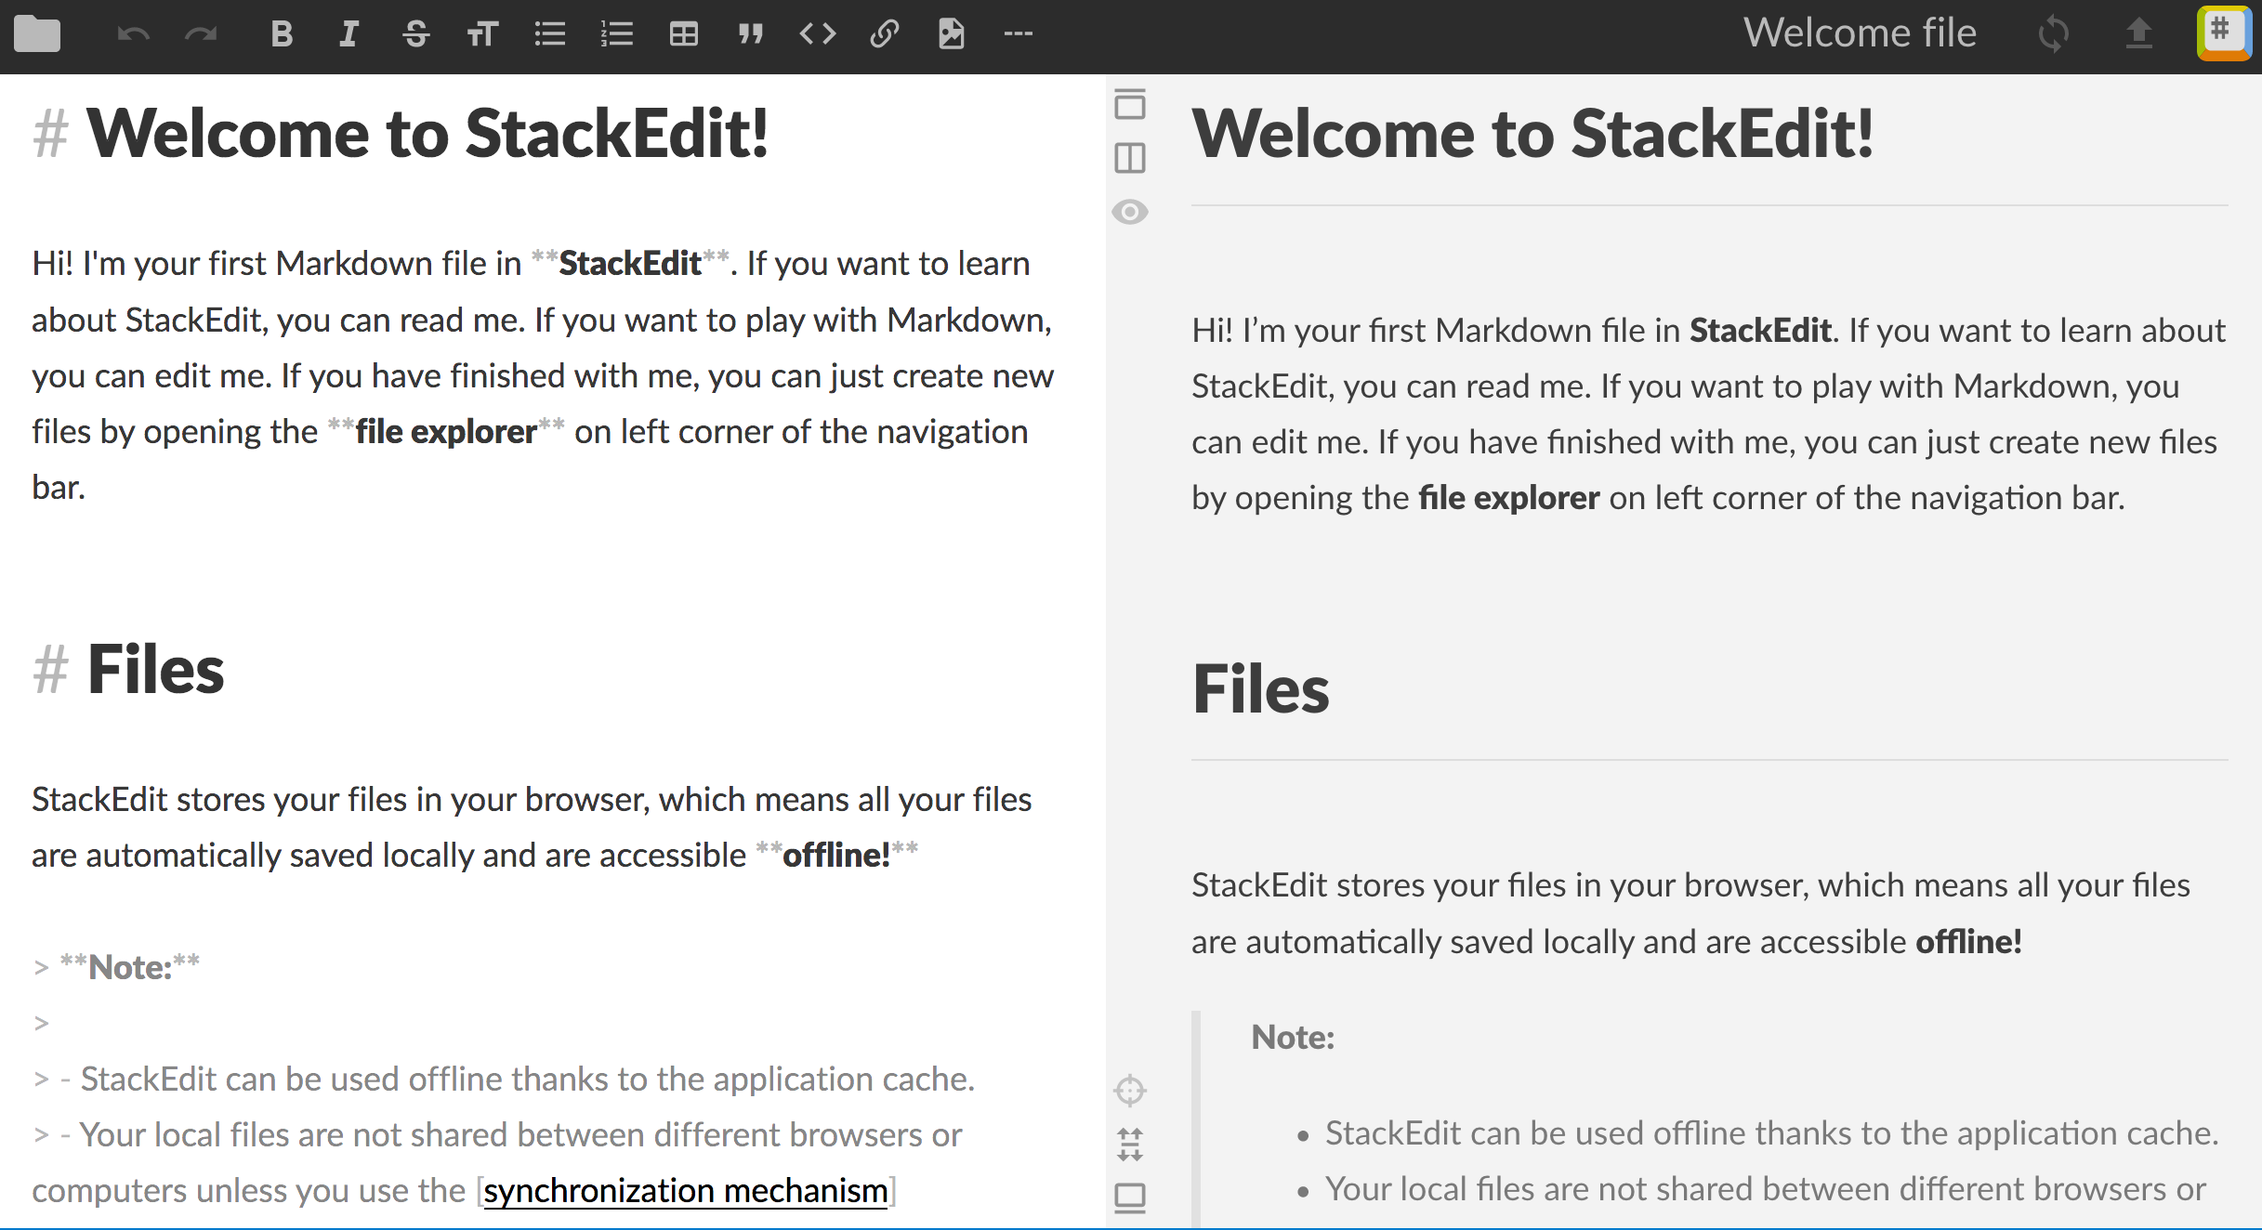
Authorea

Slide 39
New ways to publish ?

Slide 40
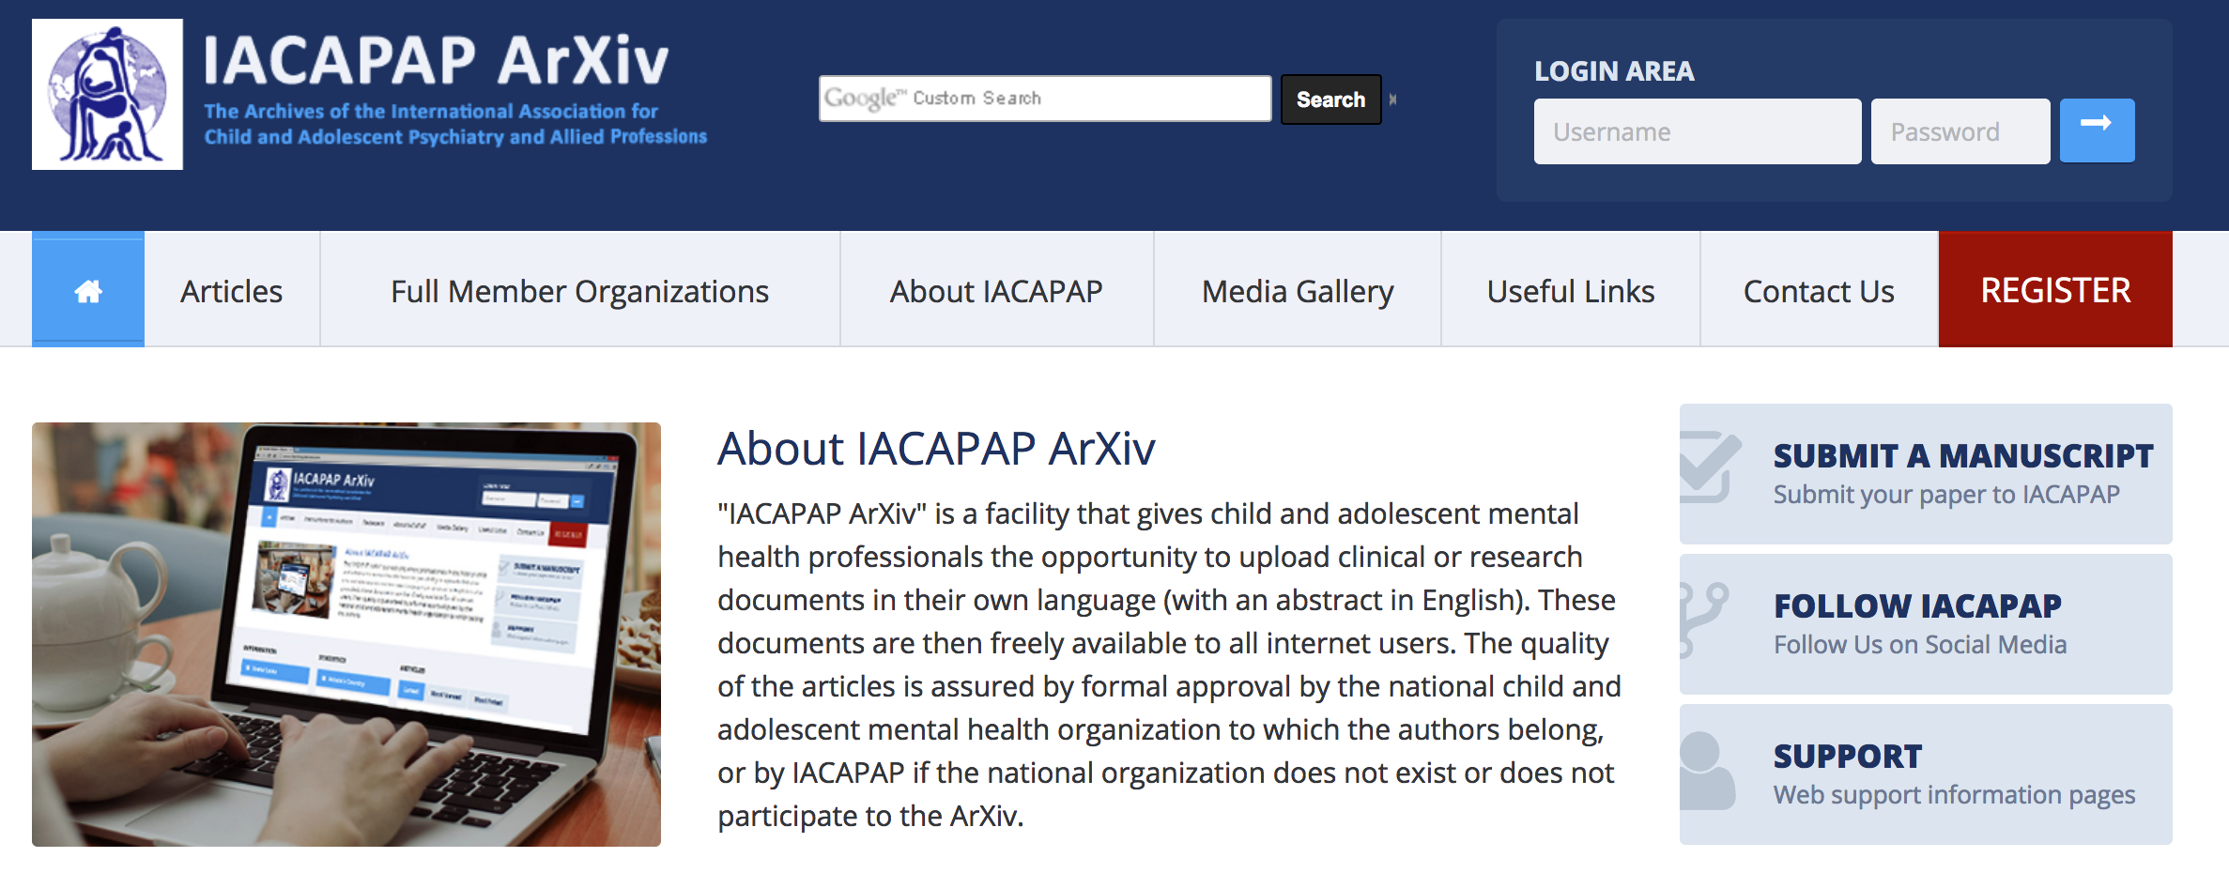



ArXiv : Preprints

Slide 41
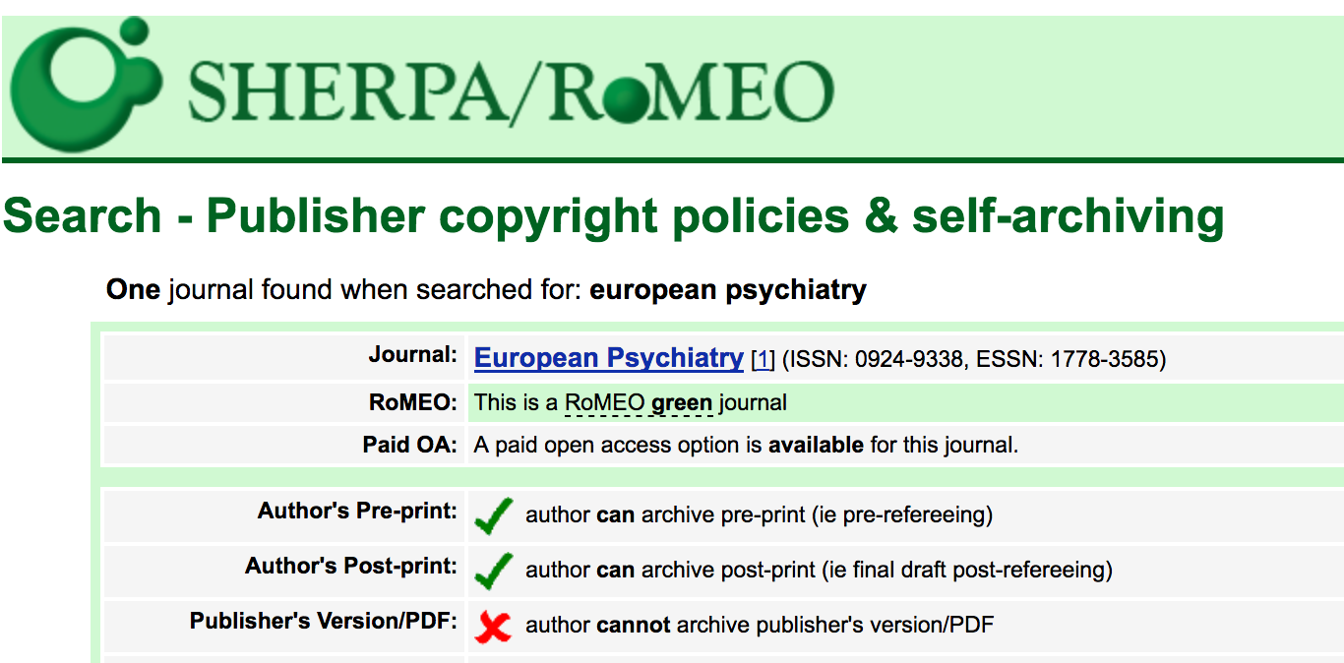
What are your rights as authors
http://www.sherpa.ac.uk/romeo/

Slide 42

https://www.pubpub.org/

Slide 44
Share to general public

Slide 45
Randomizer.org
Useful open science tools to do research in psychiatry
Collect data
Limesurvey
Analyse data
Share data
OSF and
GitHub
Write an article
Make the knowledge more visible

Slide 46
https://en.wikipedia.org/

Slide 47
https://en.wikipedia.org/

Slide 48

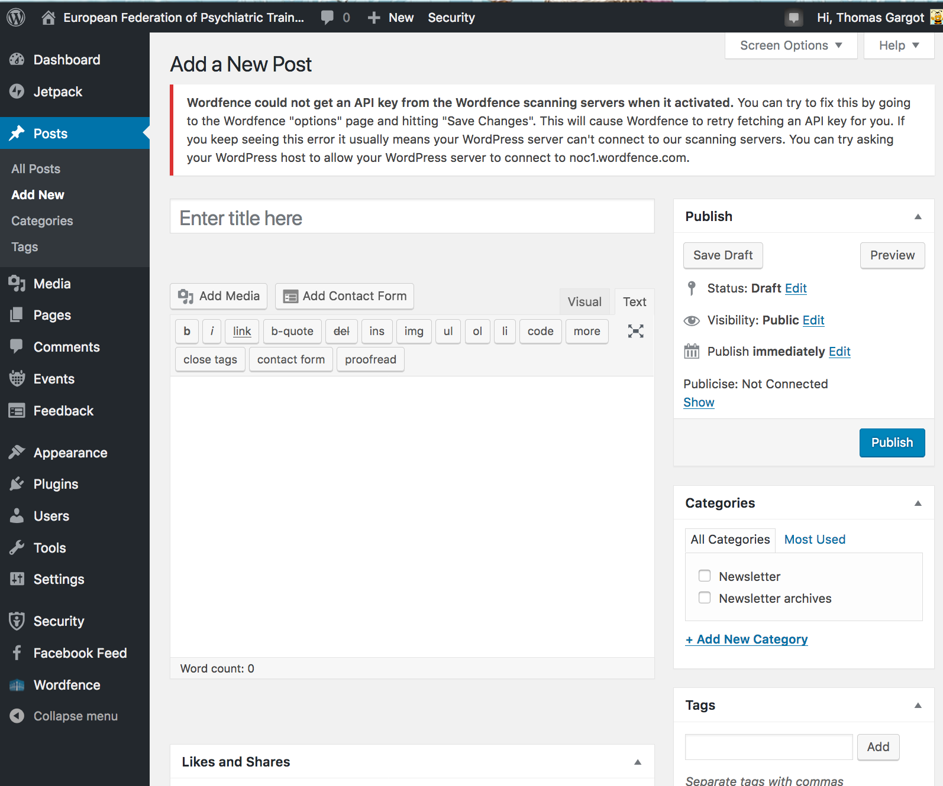
Wordpress

Slide 49
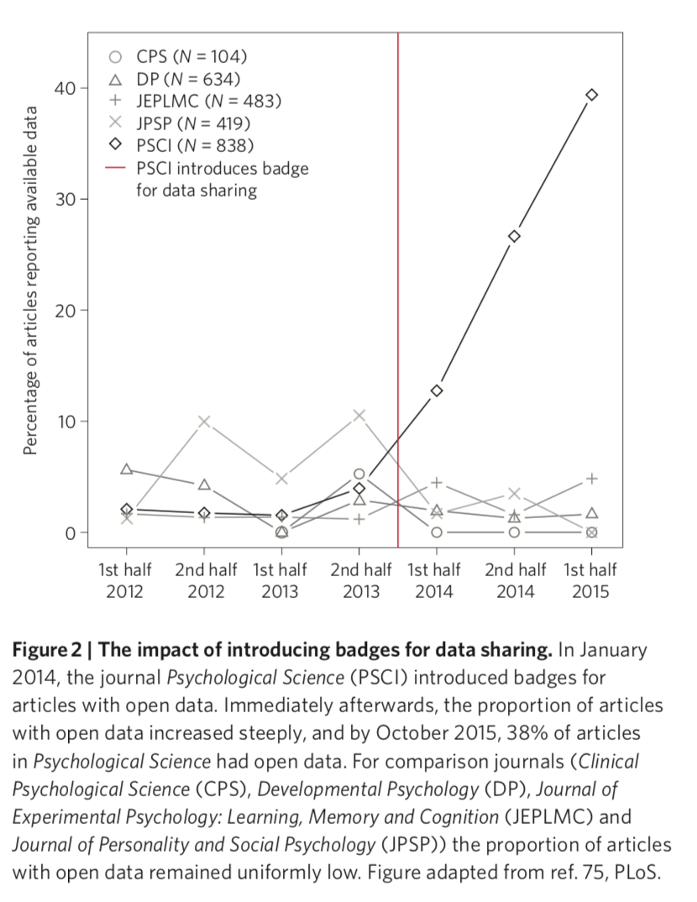



Badges

Slide 50
Randomizer.org
Useful open science tools to do research in psychiatry
Collect data :
Limesurvey
Analyse data
Share data
OSF and
GitHub
Write an article
Make the knowledge more visible

Slide 51
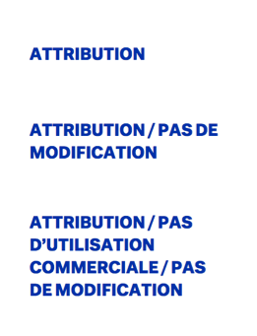
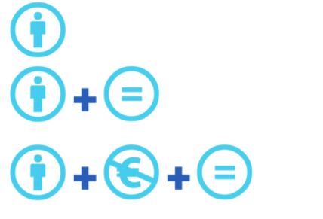
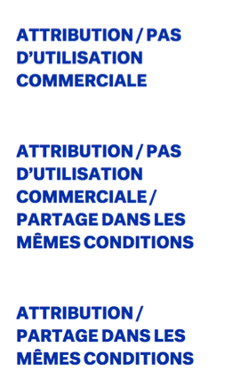


Slide 52

Thank you for your attention
thomas_gargot@hotmail.com

Slide 53
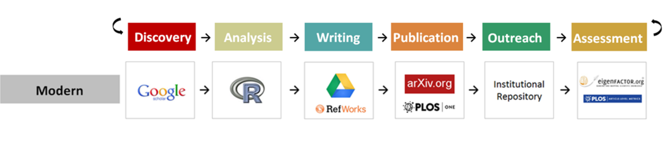
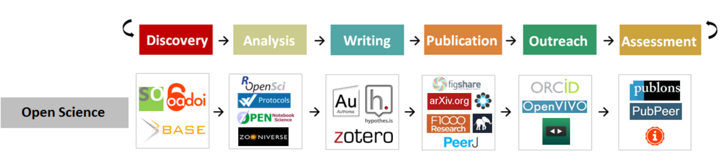
Compairing research workflows
https://101innovations.wordpress.com/workflows/

